Slide 1
Cumulative Frequency
and Quartiles

Slide 2
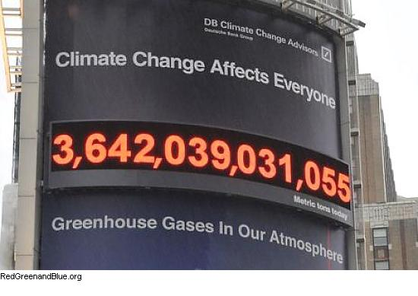
Starter
A cyclist records the number of miles he travels each week, over a period of 5 weeks. The information is shown below.
a) Plot a Cumulative Frequency curve of the information
b) Estimate when the cyclist travelled his 100th mile
Week 1
Week 2
Week 3
Week 4
Week 5
Frequency
17
19
42
38
14
C. Freq.
17
36
78
116
130

Slide 3
Starter
A cyclist records the number of miles he travels each week, over a period of 5 weeks. The information is shown below.
b) Estimate when the cyclist travelled his 100th mile
After 3 ¹/₂ weeks
CF (Miles)
200
180
160
140
120
 | Week 1 | Week 2 | Week 3 | Week 4 | Week 5
C.F | 17 | 36 | 78 | 116 | 130
100
80
60
40
20
0
0
1
2
3
4
5
Week

Slide 4
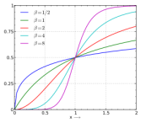
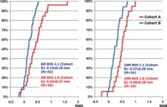
Cumulative Frequency and Quartiles
This lesson we will be learning about the ‘interquartile range’ of a set of data
We will also be looking at the median of a group of data
We will be learning how to work out this information from a Cumulative Frequency curve

Slide 5
Cumulative Frequency and Quartiles
200
The median value is the middle number of a set of data
This can be estimated from the Cumulative Frequency curve.
The median here will be the 100th value (out of 200)
This will be roughly 75-76°F
180
Cumulative Frequency
160
140
120
100
Median
80
60
40
20
0
40
50
60
70
80
90
100
Temperature (°F)

Slide 6
Cumulative Frequency and Quartiles
200
The ‘Quartiles’ are plotted ¹/₄ and ³/₄ of the way through the data
Lower Quartile = 50th value
= 67
Upper Quartile = 150th value
= 83
Inter - quartile range =
UQ – LQ
= 83 – 67 = 16
180
Cumulative Frequency
160
UQ
140
120
100
Median
80
60
LQ
40
IQR
20
0
40
50
60
70
80
90
100
Temperature (°F)
The Interquartile range tells you the range of the middle 50% of the data

Slide 7
Cumulative Frequency and Quartiles
200
The median value is the middle number of a set of data
This can be estimated from the Cumulative Frequency curve.
The median here will be the 100th value (out of 200)
This will be roughly 58 marks
180
Cumulative Frequency
160
140
120
100
80
60
40
20
0
0
20
40
60
80
100
Marks

Slide 8
Cumulative Frequency and Quartiles
200
The ‘Quartiles’ are plotted ¹/₄ and ³/₄ of the way through the data
Lower Quartile = 50th value
= 46 marks
Upper Quartile = 150th value
= 72 marks
Inter - quartile range =
UQ – LQ
= 72 – 46 = 26
180
Cumulative Frequency
160
UQ
140
120
Median
100
80
60
LQ
40
IQR
20
0
0
20
40
60
80
100
The Interquartile range tells you the range of the middle 50% of the data
Marks

Slide 9
Plenary
Below is some information taken from Cumulative Frequency Curves, looking at the weights of apples from different batches. What conclusions can you draw form comparing the two data sets?
Batch 1:
Median = 55g
Lower Quartile = 29g
Upper Quartile = 72g
Batch 2:
Median = 58g
Lower Quartile = 26g
Upper Quartile = 71g
Batch 2 has a higher Median so ‘on average’ the apples are heavier.
Batch 1 has a lower Interquartile range so the weights of the apples are more consistent here.

Slide 10
Summary
We have recapped how to plot a Cumulative Frequency Curve
We have looked at finding the Median, Lower Quartile and Upper Quartile from the curve
We have also learnt how to find the Inter-Quartile range of a set of data

